Slide 1
Machine learning presentation
PRESENTED BY:
Haris awan
REG NO:
2023-BS-AI-023
PRESENTED TO:
SIR SAEED

Slide 2
Drug classification
Introduction
Objective: The objective of this project is to develop a model capable of accurately predicting the most appropriate drug for a patient based on specific health-related attributes. These attributes include the patient's age, sex, blood pressure level, cholesterol level, and sodium-to-potassium ratio. By leveraging predictive analytics, this model can assist healthcare professionals in making faster, more data-driven decisions for prescribing medication. Ultimately, the model aims to enhance the precision and efficiency of medical treatment plans.
Overview: This is a classification problem where the model assigns each patient to one of five possible drugs.
Type of Problem: Multi-class classification
Data Source: Real-world patient health data
Goal: Streamline and support clinical decision-making through automation
Benefits: Reduces prescription errors, supports evidence-based medicine, and improves patient care outcomes

Slide 3
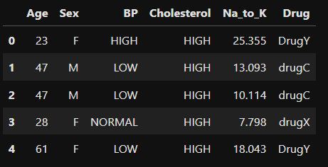
Drug classification
Dataset overview
Total Entries: 200 patient records
Features:
Age (Integer)
Sex (Categorical: Male/Female)
BP (Categorical: LOW/NORMAL/HIGH)
Cholesterol (Categorical: NORMAL/HIGH)
Na_to_K (Numeric: Sodium to Potassium ratio)
Drug (Target variable with 5 classes: DrugY, drugC, drugX, drugA, drugB)

Slide 4
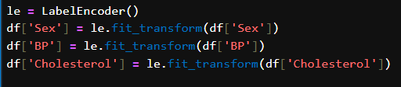

Data Preprocessing
Encoding Categorical Variables:
LabelEncoder applied to Sex, BP, Cholesterol
Feature Scaling:
Applied StandardScaler to normalize features
Train-Test Split:
80% training and 20% testing

Slide 5



Modeling
Models used
Logistic Regression
Decision Tree Classifier
Support Vector Machine (SVM)

Slide 6
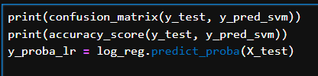
Evaluation Metrics
Accuracy Score: Measures overall correctness
Confusion Matrix: Provides insight into class-wise performance
Classification Report: Includes precision, recall, and F1-score
ROC AUC: Evaluates multi-class classification (using one-vs-rest)

Slide 7
Key findings
Sodium to Potassium Ratio (Na_to_K) is the most impactful feature in determining the drug category.
Age is also highly relevant to drug prediction.
Among the tested models, Decision Tree and SVM outperformed Logistic Regression.
The dataset’s balance and clean nature facilitated efficient model training and validation.

Slide 8
Conclusion
The machine learning approach demonstrated strong capability in classifying drug prescriptions based on input health parameters.
Preprocessing techniques like encoding, normalization, and proper splitting significantly influenced model success.
Decision Trees and SVMs showed superior classification performance, suggesting non-linear relationships in the data.
The project showcases how machine learning can aid in medical decision-making and reduce human error.
Future Scope:
Include a larger dataset for broader generalization
Use grid search for hyperparameter tuning
Explore ensemble methods like Random Forest or Gradient Boosting

Slide 9
Thanks

